Slide 1


Tabular Data Analysis
2025. 12. 03.
JangHoon Chun
Department of Medical Device Industry,
Gangnam Severance Hospital,
Yonsei University College of Medicine

Slide 2
What’s discussed in the last meetings
인체 임상 변수
영상 파생 변수
Variable | Description | Units / Classification
File Analyzed | 환자 / 케이스 식별자 | ID
Osteoporosis | 골다공증 여부 (0=정상, 1=골다공증) | Binary
Age | 나이 | 세
진료년월일 | 검사 날짜 | YYYY-MM-DD
키 | 키 | cm
체중 | 몸무게 | kg
BMI | 체질량지수 | kg/m²
허리둘레 | 허리 둘레 | cm
근육량SoftLeanMass | 부위별 평균 근육량 | kg
체지방율BodyFat | 체지방 비율 | %
체지방량FatMassKg | 체지방 총량 | kg
복부지방율WHRatio | 복부지방률 (WH Ratio) | %
복부내장지방량 | 내장지방량 | kg
복부피하지방량 | 피하지방량 | kg
초경연령ALL | 초경 시작 나이 | 세
폐경여부 | 폐경 여부 (1=예, 0=아니오) | Binary
출산횟수ALL | 출산 횟수 | Count
Variable | Description | Units / Classification
BreastArea(sqcm)AVG | 유방 전체 면적 평균 | cm²
DenseArea(sqcm)AVG | 치밀 조직 면적 평균 | cm²
BreastDensity(%)AVG | 유방 내 치밀조직 비율 | %
Breast_Density_Grading | 유방 밀도 등급 (1~4단계) | Categorical
BIRADS_Category | BI-RADS 평가 카테고리 | 1~5 등급
Group | Samples
Total | 3,961(100)
Normal | 3,475(87.7)
Osteoporosis | 486(12.3)

Slide 3
What’s discussed in the last meetings
Variable | Classification | N_Sample | mean | std | min | 25% | 50% | 75% | max
Age | Total | 3,961 | 60.3 | 7.34 | 36 | 55 | 59 | 65 | 90
 | Normal(0) | 3,475 | 59.81 | 7.07 | 36 | 55 | 59 | 64 | 86
 | Osteoporosis(1) | 486 | 63.78 | 8.18 | 48 | 58 | 62 | 69 | 90
BMI | Total | 3,961 | 23.07 | 3.12 | 12.5 | 20.9 | 22.7 | 24.8 | 42.2
 | Normal(0) | 3,475 | 23.21 | 3.12 | 12.5 | 21.1 | 22.9 | 24.9 | 42.2
 | Osteoporosis(1) | 486 | 22.07 | 2.99 | 14.3 | 20.1 | 21.8 | 24.0 | 38.1
BreastDensity(%)AVG | Total | 3,961 | 26.75 | 11.45 | 3.13 | 19.26 | 24.81 | 32.28 | 89.30
 | Normal(0) | 3,475 | 26.59 | 11.24 | 3.13 | 19.18 | 24.78 | 32.15 | 89.30
 | Osteoporosis(1) | 486 | 27.87 | 12.81 | 5.12 | 19.78 | 24.96 | 33.53 | 84.95
BreastArea(sqcm)AVG | Total | 3,961 | 122.54 | 38.10 | 27.45 | 95.33 | 117.25 | 144.23 | 377.72
 | Normal(0) | 3,475 | 123.57 | 38.38 | 27.45 | 96.75 | 118.56 | 145.10 | 377.72
 | Osteoporosis(1) | 486 | 115.22 | 35.22 | 31.55 | 88.61 | 110.13 | 137.10 | 241.37
DenseArea(sqcm)AVG | Total | 3,961 | 29.73 | 10.59 | 9.35 | 22.49 | 27.81 | 34.68 | 97.78
 | Normal(0) | 3,475 | 29.87 | 10.71 | 9.35 | 22.56 | 27.90 | 34.80 | 97.78
 | Osteoporosis(1) | 486 | 28.68 | 9.58 | 10.04 | 21.72 | 27.01 | 33.87 | 66.51
Type | Age | BMI | BreastDensity(%)AVG | BreastArea(sqcm)AVG | DenseArea(sqcm)AVG
t-stat | -10.18 | 7.86 | -2.09 | 4.84 | 2.53
p-value | <0.001 | <0.001 | 0.037 | <0.001 | 0.012

Slide 4
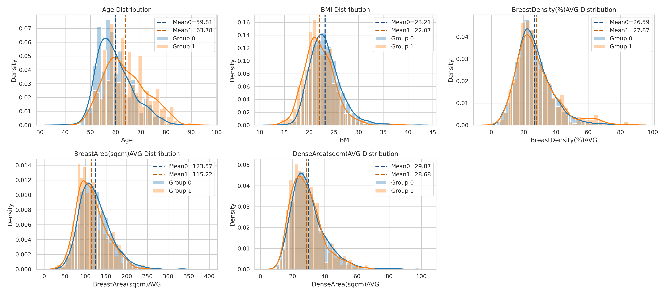
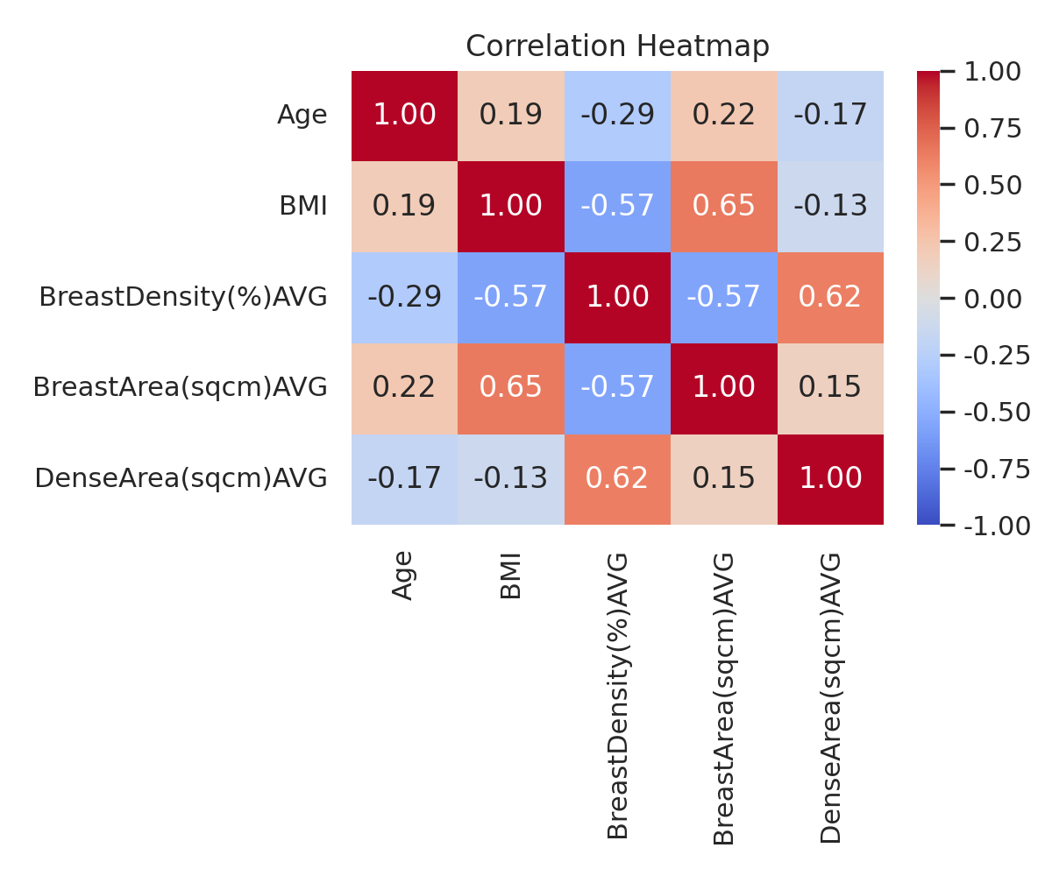
What’s discussed in the last meetings

Slide 5
Research Summary
External Dataset Validation
Conducted additional model validation using independent datasets (Diabetes, PCOS).
Diabetes classification achieved Accuracy 0.8814, Recall 0.8882, and AUC 0.9608.
PCOS classification achieved Accuracy 0.88, Recall 1.0, and AUC 0.9752.

Slide 6
Detailed Progress
Osteoporosis Diagnosis
Input: Age, BMI, BreastDensity(sqcm)AVG
Output: Osteoporosis
Feature Set | Accuracy | Precision | Recall | F1 | AUC
HoldOut (fixed params) | .6608 | .2171 | .6804 | .3292 | .7146
5-fold CV (fixed params) | .6608 | .2171 | .6804 | .3292 | .7146
HoldOut (GridSearch) | .8789 | 1.0 | .0103 | .0204 | .7118
5-fold CV (GridSearch) | .8777 |  |  |  | .7148

Slide 7
Detailed Progress
Diabetes Diagnosis Dataset
Input: gender, age, bmi, HbA1c_level, blood_glucose_level
Output: Diabetes_Diagnosis
Feature Set | Accuracy | Precision | Recall | F1 | AUC
HoldOut (fixed params) | .8814 | .4090 | .8882 | .5601 | .9608
5-fold CV (fixed params) | .8814 | .4090 | .8882 | .5601 | .9608
HoldOut (GridSearch) | .9149 | .4998 | .8335 | .6249 | .9608
5-fold CV (GridSearch) | .9149 | .4998 | .8335 | .6249 | .9608

Slide 8
Detailed Progress
PCOS Diagnosis Dataset
Input: Age, BMI, Menstrual_Irregularity, Testosterone_Level(ng/dL), Antral_Follicle_Count
Output: PCOS_Diagnosis
Feature Set | Accuracy | Precision | Recall | F1 | AUC
HoldOut (fixed params) | .8800 | .6250 | 1.0 | .7692 | .9752
5-fold CV (fixed params) | .8800 | .6250 | 1.0 | .7692 | .9752
HoldOut (GridSearch) | .9150 | .7170 | .9500 | .8172 | .9777
5-fold CV (GridSearch) | .9150 | .7170 | .9500 | .8172 | .9777

Slide 9


